Slide 1

Introduction to Unix OS
History of UNIX Operating System:
In the 1970s, Brian Kernigham did the project called Unix as the play on Multiplexed Information and Computer Service which is abbreviated as Multics.
Unix finally supplied multiple users and it was renamed as the UNIX. In the year of 1980s, the group of AT&T licensed the UNIX system III, and launched the initial version in the year of 1982, for the purpose of commercial avail.
In 2000, the SCO sold the total UNIX business including assets to the Caldera systems that later transformed its name to the SCO Group.
Java Full Stack Program

Slide 2

What is UNIX?
The UNIX Operating System (OS) is a large program (mostly coded in C) that turns the computer into a useable machine.
It provides a number of facilities:
*management of hardware resources
*directory and file system
*loading / execution / suspension of programs

Slide 3

Commands
Directory commands
cd Change the working directory
find Find a file by name or by other characteristics
mkdir Make a directory
rmdir Remove a directory
File manipulation
command scat Concatenate and display a file
cp Copy a file
grep Search a file for a specific text string
mv Move or rename a file
rm Remove a file

Slide 4
Commands
Display commands
date Print the date and time
ls List the contents of a directory
pwd Display the working directory pathname
tail Display the end of a file
Process commands
exit Terminate a process
kill Terminate or send a signal to a process
passwd Create or change a password
ps Display the status of a process
telnet Connect to a remote system using the Telnet protocol

Slide 5
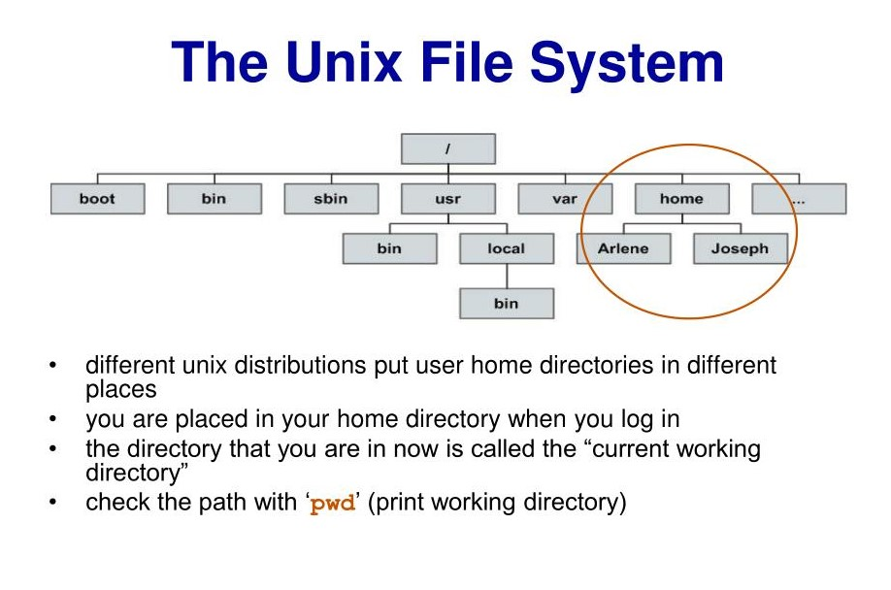
The UNIX File System
1. An upside-down Tree
2. Some System Directories
3. Pathnames
4 Commands and Pathnames

Slide 6
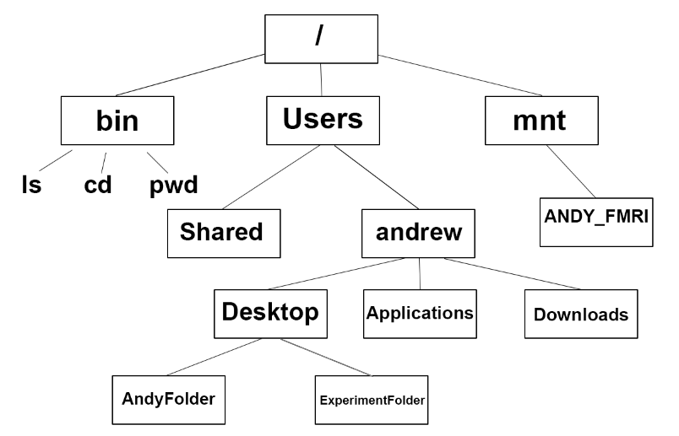
1. An Upside-down Tree
A simplified UNIX directory/file system:

Slide 7
2. Some System Directories
/bin – binary or executable programs.
/etc – system configuration files.
/home –home directory. It is the default current directory.
/opt – optional or third-party software.
/tmp – temporary space, typically cleared on reboot.
/usr – User related programs.
/var – log files.

Slide 8
3.Pathnames
A pathname in a UNIX operating system is a connected series of directory names which are separated by /’s and that recognizes the location of a directory. There are two types of pathnames and they are as follows:
Absolute pathnames
Relative pathnames

Slide 9
3.1 Absolute pathnames
The absolute pathnames are the connected series of directory names between the top of the tree and also the directory of interest.
Examples of the absolute pathname are as follows:
/bin
/export/user/shop
/export/user/shop/ad

Slide 10
3.2 Relative Pathnames
A relative pathname, on the other hand, specifies the location of a file or directory relative to the current working directory.
The current working directory is the directory that the user is currently in and is indicated by the shell prompt.
Relative pathnames do not start with the "/" symbol. For example, if the current working directory is /usr/bin, the relative pathname "ls" specifies the location of the ls command in the same directory.

Slide 11
Memory Management
Memory
Primary memory is a precious resource that frequently cannot contain all active processes in the system
The memory management system decides which processes should reside (at least partially) in main memory
It monitors the amount of available primary memory and may periodically write processes to a secondary device called the swap device to provide more space in primary memory
At a later time, the kernel reads the data from swap device back to main memory

Slide 12
UNIX Memory Management Policies
Swapping
Easy to implement
Less system overhead
Demand Paging
Greater flexibility

Slide 13
Swapping
The swap device is a block device in a configurable section of a disk Kernel
allocates contiguous space on the swap device without fragmentation
It maintains free space of the swap device in an in-core table, called map
The kernel treats each unit of the swap map as group of disk blocks
As kernel allocates and frees resources, it updates the map accordingly

Slide 14
Demand Paging
Not all page of process resides in memory
Locality
When a process accesses a page that is not part of its working set, it incurs a page fault.
The kernel suspends the execution of the process until it reads the page into memory and makes it accessible to the process

Slide 15
Why Use UNIX?
Portability:
UNIX is designed to be portable, which means that it can run on a variety of hardware platforms and is not tied to a specific architecture.
This makes it easier for developers to write applications that can run on multiple UNIX platforms without modification.
Robustness:
UNIX is known for its robustness and reliability. The system is designed to handle multiple tasks at the same time and can continue to operate even if one process fails.
This makes UNIX an ideal choice for mission-critical applications.

Slide 16
Why Use UNIX?
Security:
UNIX has built-in security features that protect against unauthorized access to system resources.
It also has a comprehensive security model that allows administrators to control access to files and directories based on user and group permissions.
Customizability:
UNIX is highly customizable, and administrators can modify the system to meet their specific needs.
The system can be configured to run a variety of applications and services, and administrators can add new functionality by installing new software packages.

Slide 17
Why Use UNIX?
Interoperability:
UNIX provides a rich set of tools for interconnecting systems and for communicating between applications.
This makes it easy for UNIX systems to work together and exchange data.
Ecosystem:
UNIX has a large and active user community, and a rich ecosystem of applications, utilities, and tools has developed around it.
This makes it easy for users to find solutions to common problems, and for developers to create new applications.

Slide 18
Applications
Storage Consultancy
Expert advice on all forms of storage technologies.
Storage management software.
Solutions that can grow and evolve as your business does.
fully trained and accredited consultants.
Independent recommendations on storage technologies.
Full project management to implement storage technologies.

Slide 19
Applications
Middleware & Database Administration
Installation and configuration of WebLogic and Websphere application servers in highly available clustering environment.
Understanding the complexities of infrastructure design and maintenance, analyze architecture and security issues Hardening productions environments.
Assisting clients in aspects of deploying J2EE applications and connecting to back end resources.
Providing development and production environments. Finding performance bottlenecks and tuning of existing Websphere or WebLogic applications servers.

Slide 20
Shell Commands
What is Unix Shell Commands?
Unix shell commands are one of the four layers of Unix architecture, enabling human interaction with the operating system to intimate it to begin certain processes by giving commands through the interpreter.
It consists a set of commands like cp, grep, cat, id, mv etc., that are pre-defined and stored in the libraries.
Unix shell commands are of three types basic, intermediate and advanced, consisting of various commands like ls, cat, rm, mv, mkdir, chomp, find, chown, chgrp, head, tail, grep, ln, cut etc.

Slide 21
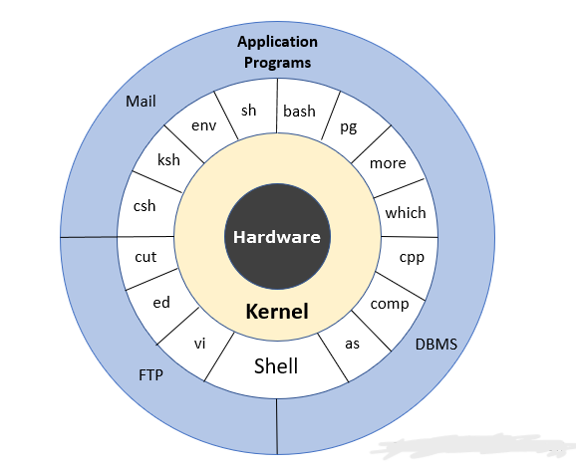
UNIX Architecture
Here is the following UNIX architecture mention below

Slide 22
Layer-1: Hardware
This layer consists of all the hardware resources being used.
Layer-2: Kernel
The kernel is like the heart of the operating system.
It is the mode of interaction between the hardware and operating system.
It also manages tasks, resources using scheduling processes for the smooth functioning of the system.

Slide 23
Layer-3: Shell commands
It is the way for a human to interact with the operating system and tell it to start certain processes.
An interpreter is used where we give the command for the operating from the set of all commands for which the definition has been defined and stored in the libraries.
Some examples of commands are cp, mv, cat, grep, id, wc, nroff, a.out and more.
Layer-4: Application Layer
It executes the given external applications. It is an outermost layer to execute the applications.

Slide 24
List of Unix Shell Commands
Here is the list of the following Unix Shell Commands mention below:
Basic.
Intermediate.
Advanced.

Slide 25
Basic Unix Shell Commands
cd: Change the current directory
pwd: Print the current working directory
mkdir: Create a new directory
rmdir: Remove an empty directory
touch: Create a new file or update the modification time of an existing file
cp: Copy files or directories
mv: Move or rename files or directories
rm: Remove files or directories

Slide 26
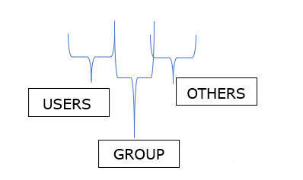
2. Intermediate
Chmod
Sometimes, when we need to write into the file that is write-protected, we need to change the permissions given to a file or directory.
Here ‘chmod’ command is used to give suitable permissions. But one should know the pattern for giving permissions.
Permissions are given as rwxrwxrwx

Slide 27
B. Find
This command is used to find the files or directories in a particular directory and its subdirectories.
Syntax
“find <options> <paths>”
Example
atime n Returns true if the file was accessed n days ago
ctime n Returns true if the file was changed n days ago
Mtime Returns true if file contents were modified n days ago
Name Return true if filename matching a particular pattern
Size Returns true if the file size is n blocks.

Slide 28
C. chown
change ownership of the file.
Sometimes someone wants to change the owner of the file so that someone who is currently working in that file has all access to that file.
Only the owner of the file has the right to change the file ownership.
Syntax:
“ chown [owner] [file] ”
Example:
Change the owner of test1 to user name ‘aaggasa’, assuming that the current user currently owns it
“ chown aaggasa test1 ”

Slide 29
D. Chgrp
change the group ownership of the file.
This command is used to change the group to which the file belongs.
Only the owner of the file has the right to change the file ownership.
Syntax:
“ chgrp [group] [file] ”
Example:
Change the group of test1 to group2, assuming the current user currently owns it.
“ chgrp group2 test1 ”

Slide 30
E. Head
Unix gives us this command-line utility to extract the first part of the file.
It writes the result on standard output.
Syntax
“ head <option> <filename> ”
n Used to specify the number of lines to be fetched
c Used to specify the number of bytes to be fetched.
q Used to suppress the header line.
Example
If someone wants to extract the first 5 lines of the file, we must use
“ >head –n 5 /abi/sand/test1.dat ”

Slide 31
Thank you!

